Slide 1

Image Processing for Tuberculosis Detection in Sputum Samples
Leader : Alvin Linardi - 2602077553
Member : Kanaya Ravensca Childira - 2602061353
Notes:
Tuberculosis symptoms might include a persistent cough with or without blood, as well as discomfort in the chest, weakness, fatigue, a loss of appetite, a high body temperature, and sweating throughout the night

Slide 2
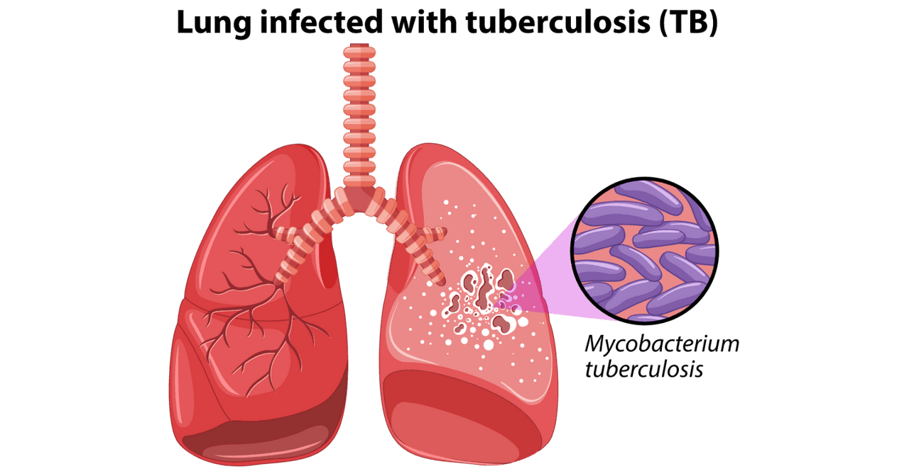
Tuberculosis
Tuberculosis (TB) is a contagious respiratory disease caused by the bacterium Mycobacterium tuberculosis (Adigun & Singh, 2023). The disease is spread through the air when an infected person coughs, sneezes or spits, posing a risk to those nearby.
Although preventable and curable with antibiotics, TB remains a significant global health challenge. About a quarter of the world's population has been infected with Mycobacterium tuberculosis, with 5-10% eventually developing TB symptoms. In 2022 alone, tuberculosis claimed the lives of 1.3 Million people (World Health Organization, 2023).

Slide 3
Symptoms
Risk Factors
Persistent coughs with or without blood
Discomfort in the chest
Weakness
Fatigue
Loss of appetite
A high body temprature
Night Sweats
A compromised immune system
HIV / AIDS
Diabetes
Malnutrion
Use of Tobacco Products
Symptoms & Risk Factors
Notes:
Tuberculosis symptoms might include a persistent cough with or without blood, as well as discomfort in the chest, weakness, fatigue, a loss of appetite, a high body temperature, and sweating throughout the night
A compromised immune system like HIV and AIDS, diabetes, malnutrition, and the use of tobacco products all increase the risk of acquiring tuberculosis

Slide 4
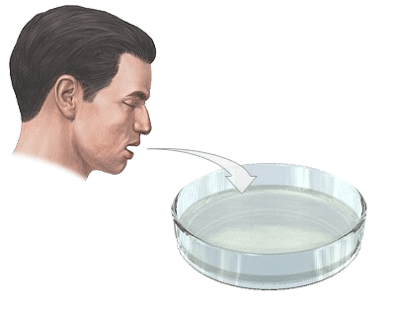
Early Identification
Early identification is crucial in preventing the spread of tuberculosis. Individuals should seek medical attention if experiencing symptoms, undergo testing if at risk, complete prescribed treatment, and practice good hygiene, including having proper coughing and sputum disposal etiquette (Lovering, 2023).
Sputum Test
One method of diagnosing tuberculosis is through a sputum test, which involves collecting sputum from inside the lungs where TB bacteria may be present (MN Department of Health, 2023).
The sample undergoes smear analysis and sputum culture in the laboratory to detect Mycobacterium tuberculosis.

Slide 5
Challenges of Traditional Methods
Take it takes up a lot of time
Subjectivity and inter-observability
Reliance of Specialized Equipments in resource limited areas

Slide 6


Our Solution
Automation which combines machine learning and image processing, offers a promising solution to overcome these challenges. Machine learning algorithms can standardize and objectively analyze sputum samples, reducing variability and improving reliability.
In addition, automation can speed up result turnaround time and reduce labor intensity, and can adapt to low-cost computing platforms, thereby improving accessibility in resource-constrained areas.

Slide 7
Literature Review
Standardization and Objectivity: Evident in papers such as Alsaffar et al. (2021), which uses SVM, Logistic Regression, and K-Nearest Neighbours to classify chest X-ray images and Yashwant Kurmi et al. (2021), which utilizes image enhancement, bacteria region masking, and Bayesian optimization for segmentation and classification without any assistance from humans.
Faster Result Turnaround Time: Automation can speed up result turnaround time, which is critical in healthcare. Papers such as Amarech Kiﬂie et al. (2023) and Yikai Xu and Philippe Lambin (2022) show that automated systems can quickly process and analyze images, reducing the time required for diagnosis.
Accessibility in Resource-Constrained Areas: Automation can adapt to low-cost computing platforms, making it more accessible in resource-constrained areas. Papers such as Amarech Kiﬂie et al. (2023), Yikai Xu and Philippe Lambin (2022) demonstrate the feasibility of using automated systems in resource-constrained settings due to its portability and low-resource costs.

Slide 8


State of The Art Method
Methods used in this research will involve usage of Convolution Neural Network (CNN) Algorithm as part of deep learning which works around the usage of image processing as a pre-trained model. The pre-trained model itself is acquired by the usage of torchvision model library collection which have pre-trained model and have been tested to the COCO (Common Object Context) Dataset which is a popular dataset used to establish pre-trained model. For this research,
FasterRCNN_Resnet50_FPN will be used as the main pre-trained model to processed the dataset. The dataset used in this research is Tuberculosis image dataset 19d4ae81-a which contains 2530 images of sputum samples which were the main sample used in medical diagnosis of Tuberculosis Disease.

Slide 9

Methods to Compare

Slide 10
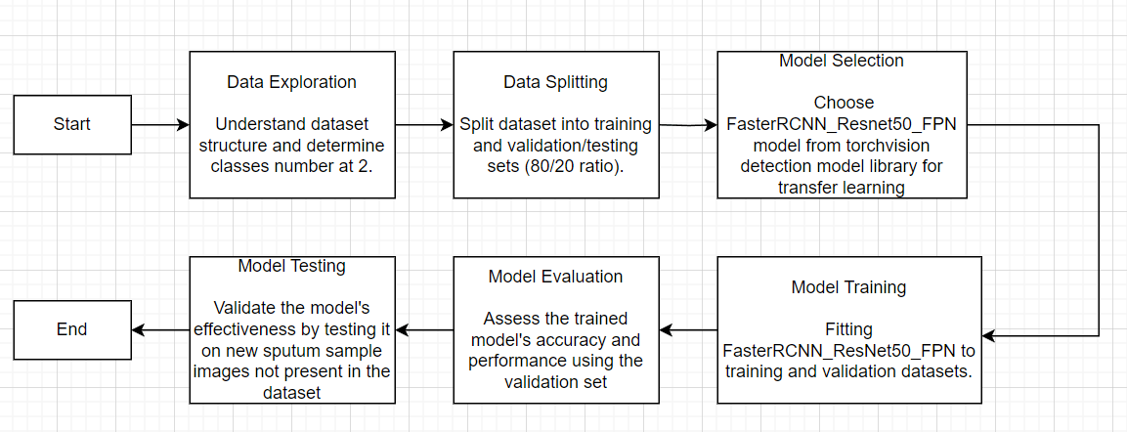
Methodology Workflow

Slide 11
Numerical Result
Model Name | Precision | Recall | Accuracy | F1 Score | Average IoU | Average Dice Score
FasterRCNN_ResNet50_FPN | 59.12% | 94.92% | 57.30% | 72.86% | 86.89% | 92.27%
FasterRCNN_ResNet50_FPN_V2 | 63.10% | 96.08% | 61.52% | 76.16% | 87.86% | 92.81%
FasterRCNN_MobileNet_V3_Large_FPN | 58.54% | 65.85% | 44.91% | 61.98% | 83.74% | 90.32%
FasterRCNN_MobileNet_V3_Large_320_FPN | 81.70% | 10.03% | 9.81% | 17.86% | 80.68% | 88.54%

Slide 12
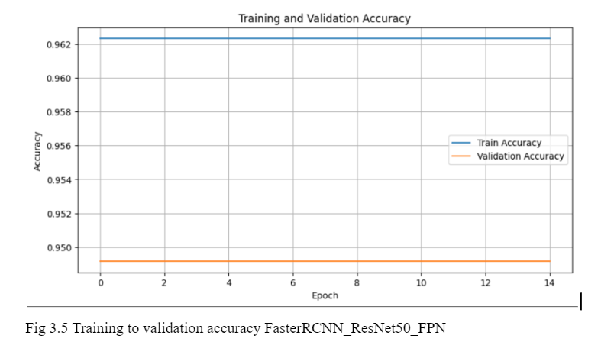
Graphical Results (1/4)

Slide 13
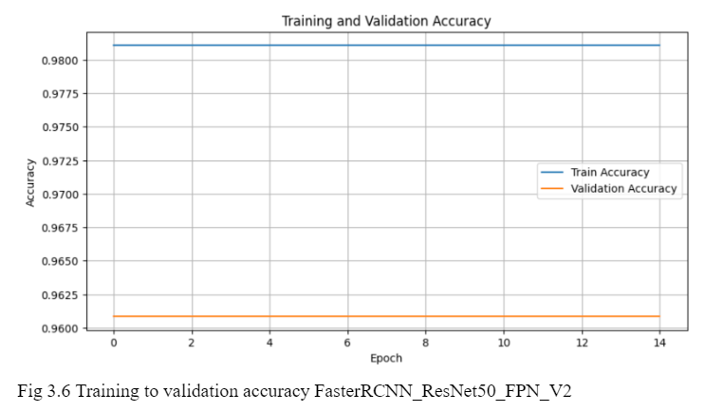
Graphical Results (2/4)

Slide 14
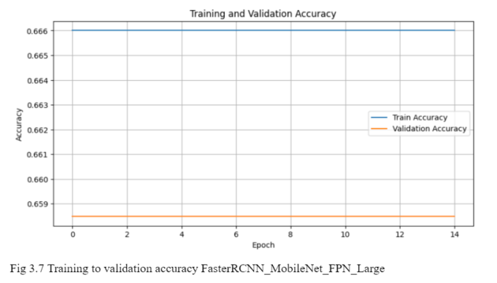
Graphical Results (3/4)

Slide 15
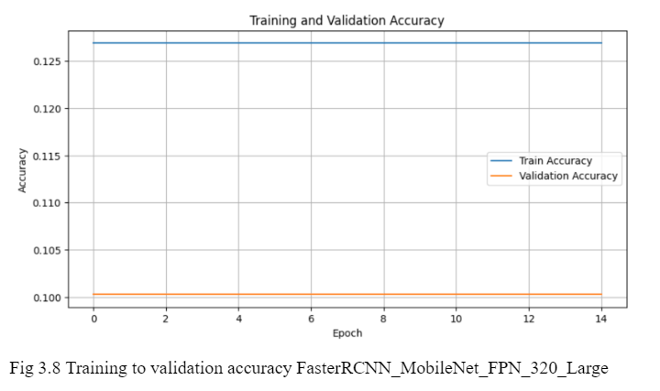
Graphical Results (4/4)

Slide 16
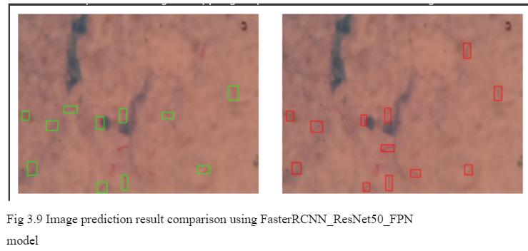
Prediction Results (1/4)

Slide 17
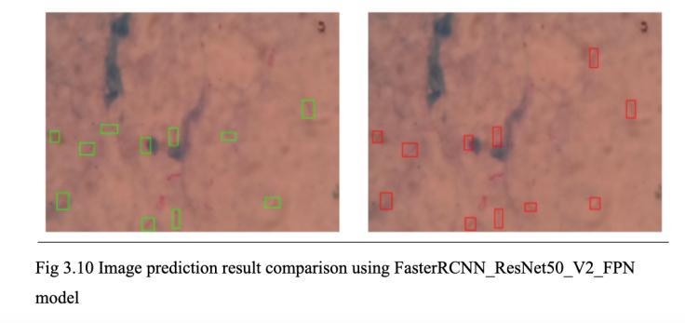
Prediction Results (2/4)

Slide 18
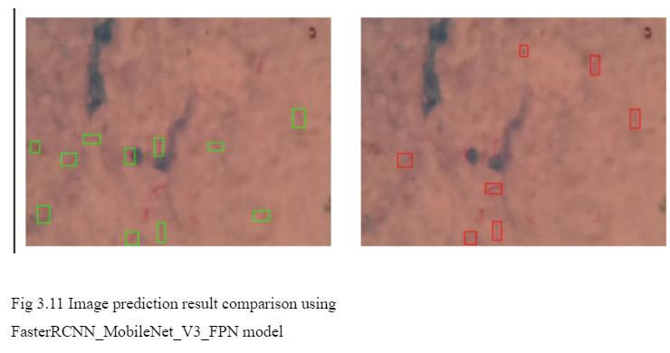
Prediction Results (3/4)

Slide 19
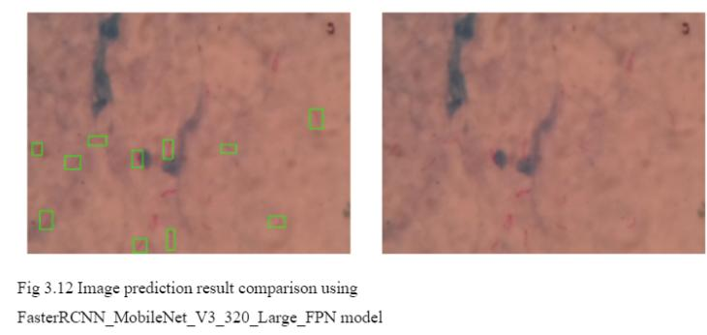
Prediction Results (4/4)

Slide 20

Conclusion
In a recent study, computational biology techniques, including machine learning and image processing, were utilized to detect tuberculosis in sputum samples using a Convolutional Neural Network (CNN). The model, which was trained on images of sputum samples, demonstrated high precision, accuracy, and recall, indicating the effectiveness of automated systems in improving diagnostic processes. Notably, the model's compatibility with minimal computational resources makes it especially advantageous in resource-limited settings where tuberculosis is prevalent.
The results advocate for incorporating artificial intelligence into medical diagnostics to enhance the speed and accuracy of tuberculosis detection, which could improve patient outcomes. Future research should aim to expand the dataset, improve model accuracy, test its clinical applicability, and increase the interpretability of model decisions to foster wider acceptance in medical practice.

Slide 21













Thank You

